Slide 1


Development of a Ping Pong Game using Python
Presented by: Harshad Jani Ahamad

Slide 2

Let’s Get Started
Introduction
Libraries and Modules
Setting Up the Game Window
Creating Game Objects
Score Initialization
Game Functions
Keyboard Bindings
Main Game Loop
Code Implementation
Conclusion

Slide 3

Introduction
Overview of the Game
The Ping Pong Game, inspired by the classic arcade game Pong, is a simple yet engaging two-player game designed using Python's graphical and event-handling capabilities. It provides a platform for players to compete against each other by controlling paddles to hit a bouncing ball, aiming to score points by getting the ball past their opponent.
This project focuses on implementing core programming concepts, such as event-driven programming, collision detection, and graphical user interfaces, using Python libraries like turtle, winsound, and tkinter. The simplicity of the game mechanics makes it accessible to beginners while also providing scope for advanced features.

Slide 4
Objective of the project
Objective Of The Project
The primary goal of the Ping Pong Game is to demonstrate the principles of game development while offering an interactive experience. Each player controls a paddle to prevent the ball from crossing their side of the screen while attempting to score by passing the ball beyond their opponent. The game fosters reflex-based gameplay and promotes competitive spirit.
Additionally, this project aims to achieve the following:

Slide 5
Scope Of The Project
Technical Scope: Implements game mechanics like paddle movement, ball dynamics, and collision detection using Python. Integrates libraries (turtle, winsound) for graphical interface and sound effects.
Educational Scope: Strengthens programming skills and event-driven programming concepts. Serves as a foundation for advanced features like AI and multiplayer gameplay.
User Engagement Scope: Provides interactive two-player gameplay. Offers customizable settings for paddle size, ball speed, and colors.

Slide 6

Applications & Tools of the Project
Python Language
Used for coding the entire game logic, handling user inputs, and managing the game flow.
Turtle Graphics Library
Provides the graphical interface for drawing paddles, the ball, and the game window.
Winsound Library
Used to play sound effects, like the "boing" sound when the ball hits a paddle, for an interactive experience.
Tkinter Library (via Turtle)
Provides the windowing system that enables the game to run on a graphical interface, though not directly used in the code.

Slide 7


Project Design

Slide 8

Game Window Design
A graphical interface created using Python's turtle library.
Components:
Background: Black screen for better contrast.
Displays "Ping Pong Game" on the window bar.
Score Display: Positioned at the top to track scores in real-time.

Slide 9

Game Objects
Paddles
Two rectangular paddles (Player A and Player B) with adjustable sizes and colors.
Positioned on opposite sides of the screen, moving vertically.
Ball:
A circular object with dynamic movement and color contrast for visibility.
Includes speed and direction control logic.

Slide 10
Gameplay Mechanics
Gameplay Mechanics
Collision Detection:
Ball rebounds on hitting paddles or screen borders.
Scoring System:
Updates player scores dynamically when the ball crosses boundaries.
Keyboard Controls:
Arrow keys for Player A, specific keys for Player B.

Slide 11

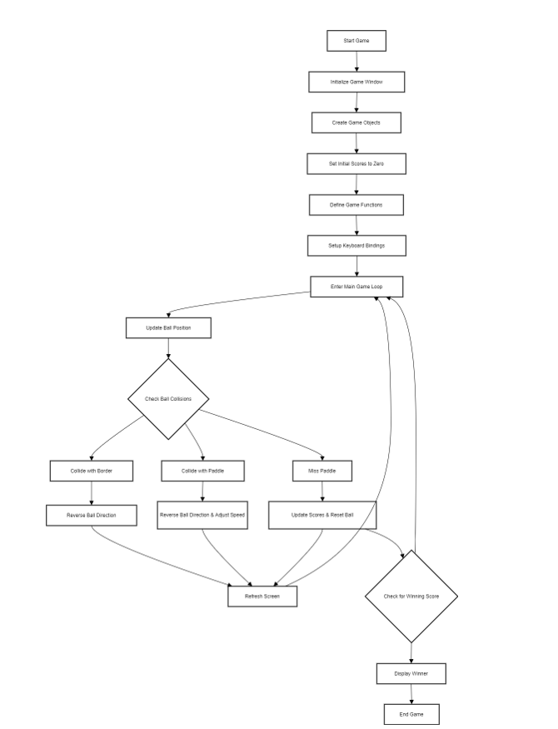

Flow Chart

Slide 12
Testing and Validation
Functional Testing
Objective: Verify that all game features work as expected.
Key Areas Tested:
Paddle movement responds correctly to keyboard inputs.
Ball movement follows the expected trajectory.
Collision detection with paddles and borders.
Score increments accurately when the ball crosses the boundary.

Slide 13
Usability Testing
Objective: Confirm ease of use and intuitive controls.
Key Insights:
Players can easily control paddles using assigned keys.
Scores are clearly visible during gameplay.
Interface is user-friendly and engaging.
Performance Testing
Objective: Ensure smooth gameplay without lags or crashes.
Key Tests:
Monitor frame rate during rapid ball movements.
Validate responsiveness of the main game loop under prolonged play.
Validation Outcomes
All functional requirements met successfully.
Gameplay was smooth and responsive under different conditions.
User feedback indicated satisfaction with the controls and interface.

Slide 14
Challenges Faced
Collision Detection
Issue: Accurate ball rebound from paddles.
Solution: Implemented precise proximity checks for proper bounce
Ball Speed Balance
Issue: Maintaining fair but challenging ball speed.
Solution: Adjusted speed dynamically during gameplay.
Code Efficiency
Issue: Ensuring smooth performance during gameplay.
Solution: Optimized screen refresh with turtle.tracer().
Screen Border Collisions
Issue: Ball escaping the window.
Solution: Added collision logic to reverse ball direction at borders.

Slide 15
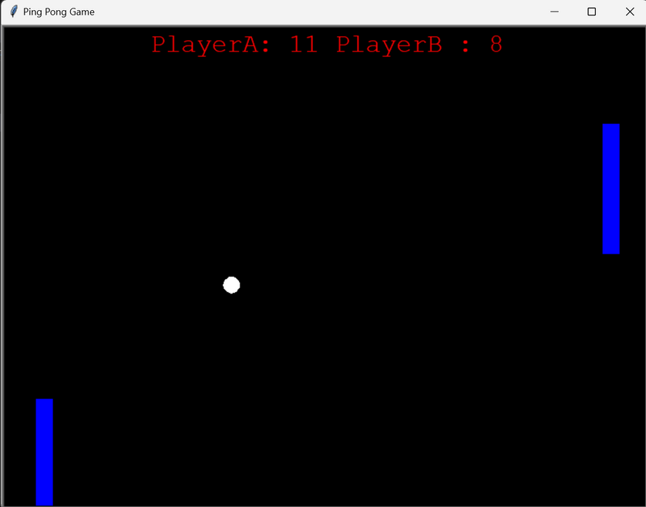
Conclusion
Project Summary :Successfully developed a functional and interactive Ping Pong game using Python. Implemented core features like paddle movement, collision detection, scoring,and dynamic ball motion.
Learning Outcomes: Enhanced understanding of Python libraries (turtle, winsound).
Gained experience in game mechanics, real-time interaction,and graphical design.
Future Scope: Add features like difficulty levels, single-player mode, enhanced graphics, and online multiplayer support.
Final Note:The project demonstrates practical application of programming concepts and serves as a foundation for more advanced game development projects.

Slide 16
Limitations of the Project
Single Player Only : No AI opponent; requires two players for gameplay.
Basic Graphics :Limited visual appeal with simple shapes and colors.
No Difficulty Levels: Ball speed and paddle size remain constant, lacking progressive challenges.
Limited Audio Effects :Minimal sound design with basic collision feedback
No Online Multiplayer :Gameplay restricted to local controls without network support.

Slide 17
References:
Python Documentation :
Official Python documentation for understanding libraries like turtle, winsound, and tkinter.
https://docs.python.org
YouTube Tutorials
Step-by-step guides for creating basic games using Python.
Example: "Python Pong Game Tutorial for Beginners."
Online Coding Platforms
Resources like GeeksforGeeks, W3Schools, and Stack Overflow for coding logic and troubleshooting.
https://www.geeksforgeeks.org https://stackoverflow.com
Books on Python Game Development
Example: Python Crash Course by Eric Matthes for beginner-friendly game development concepts.

Slide 18
Thank you

